Slide 1


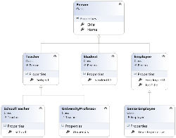







Common Type System
.NET Types Hierarchy, Cloning, Comparing, Value and Reference Types, Parameters Passing
Svetlin Nakov
Technical Trainer
www.nakov.com
Telerik Software Academy
Common Type System
academy.telerik.com

Slide 2

Table of Contents
What is Common Type System (CTS)?
Types Hierarchy
The System.Object type
Overriding the Virtual Methods in System.Object
Operators is and as
Object Cloning
ICloneable Interface
The IComparable<T> Interface

Slide 3

Table of Contents (2)
The IEnumerable<T> interface
Value Types and Reference Types
Boxing and Unboxing
Passing Parameters
Input, Output and Reference Passing

Slide 4

What is Common Type System (CTS)?

Slide 5
What is CTS?
.NET Common Type System (CTS)
Defines CLR supported
Data types
Operations performed on them
Extends the compatibility between different .NET languages
Supports two types of data
Value types
Reference types
All data types are inheritors of System.Object

Slide 6
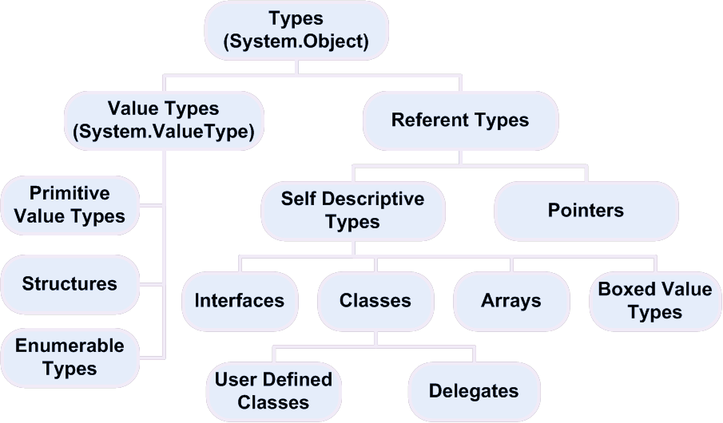
.NET CTS Types Hierarchy

Slide 7
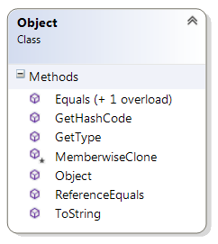
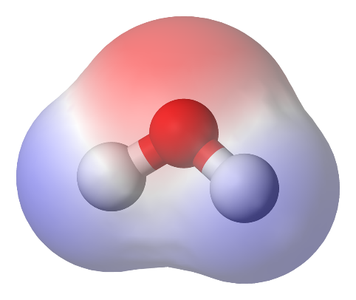

The System.Object Type

Slide 8
System.Object Type
Base class for each .NET type
Inherited by default when a new type is defined
Important virtual methods:
Equals() – comparison with other object
ToString() – represents the object as a string
GetHashCode() – evaluates the hash code (used with hash-tables)
Finalize() – used for clean up purposes when an object is disposed

Slide 9

Overriding the Virtual Methods in System.Object

Slide 10
Overriding System.Object's Virtual Methods
By default the operator == calls the ReferenceEquals() method
Compares the addresses for reference types
Or the binary representation for value types
The methods Equals(), GetHashCode() should be defined at the same time
The same applies for the operators == and !=
You can override Equals() and use its implementation for == and !=

Slide 11
Overriding System.Object Methods – Example
public class Student
{
public string Name { get; set; }
public int Age { get; set; }
public override bool Equals(object param)
{
// If the cast is invalid, the result will be null
Student student = param as Student;
// Check if we have valid not null Student object
if (student == null)
return false;
// Compare the reference type member fields
if (! Object.Equals(this.Name, student.Name))
return false;
// Compare the value type member fields
if (this.Age != student.Age)
return false;
return true;
}
// the example continues

Slide 12
Overriding System.Object Methods – Example (2)
public static bool operator == (Student student1,
Student student2)
{
return Student.Equals(student1, student2);
}
public static bool operator !=(Student student1,
Student student2)
{
return !(Student.Equals(student1, student2));
}
public override int GetHashCode()
{
return Name.GetHashCode() ^ Age.GetHashCode();
}
}

Slide 13
Overriding the Virtual Methods in System.Object
Live Demo

Slide 14
More About System.Object
The System.Object type has some other methods, which are inherited by all .NET types:
GetType()
Returns type's metadata as a System.Type
MemberwiseClone()
Copies the binary representation of the variable into a new variable (shallow clone)
ReferenceEquals()
Compares if two object have the same reference

Slide 15

is and as operators
as
is

Slide 16

Type Operators in C#
The is operator
Checks if an object an is instance of some type
Polymorphic operation
5 is Int32
5 is object
5 is IComparable<int>
The as operator
Casts a reference type to another reference type
Returns null value if it fails
E.g. if the types are incompatible

Slide 17
Operators is and as – Example
class Base { }
class Derived : Base { }
class TestOperatorsIsAndAs
{
static void Main()
{
Object objBase = new Base();
if (objBase is Base)
Console.WriteLine("objBase is Base");
// Result: objBase is Base
if (! (objBase is Derived))
Console.WriteLine("objBase is not Derived");
// Result : objBase is not Derived
if (objBase is System.Object)
Console.WriteLine("objBase is System.Object");
// Result : objBase is System.Object
// the example continues

Slide 18
Operators is and as – Example (2)
Base b = objBase as Base;
Console.WriteLine("b = {0}", b);
// Result: b = Base
Derived d = objBase as Derived;
if (d == null)
Console.WriteLine("d is null");
// Result: d is null
Object o = objBase as Object;
Console.WriteLine("o = {0}", o);
// Result: o = Base
Derived der = new Derived();
Base bas = der as Base;
Console.WriteLine("bas = {0}", bas);
// Result: bas = Derived
}
}

Slide 19

Operators is and as
Live Demo

Slide 20

Object Cloning

Slide 21
Object Cloning
In programming cloning an object means to create an identical copy of certain object
Shallow cloning (shallow copy)
Uses the protected MemberwiseClone() method
Copies the value types bit by bit (binary)
Copies only the addresses of the reference types
Deep cloning (deep copy)
Recursively copies all member data
Implemented manually by the programmer

Slide 22
Object Cloning (2)
Types which allow cloning implement the ICloneable interface
The Clone() method of the ICloneable
The only method of the interface
Returns an identical copy of the object
Returns object → must be casted later
You decide whether to create a deep or shallow copy or something between

Slide 23
Object Cloning – Example
class LinkedList<T>: ICloneable
{
public T Value { get; set; }
public LinkedList<T> NextNode { get; private set; }
public LinkedList(T value,
LinkedList<T> nextNode = null)
{
this.Value = value;
this.NextNode = nextNode;
}
object ICloneable.Clone() // Implicit implementation
{
return this.Clone();
}
// the example continues

Slide 24

Object Cloning – Example (2)
public LinkedList<T> Clone() // our method Clone()
{
// Copy the first element
LinkedList<T> original = this;
T valueOriginal = original.Value;
LinkedList<T> result = new LinkedList<T>(valueOriginal);
LinkedList<T> copy = result;
original = original.NextNode;
// Copy the rest of the elements
while (original != null)
{
valueOriginal = original.Value;
copy.NextNode = new LinkedList<T>(valueOriginal);
original = original.NextNode;
copy = copy.NextNode;
}
return result;
}

Slide 25

Deep and Shallow Object Cloning
Live Demo

Slide 26

The Interface IComparable<T>

Slide 27

IComparable<T> Interface
The System.IComparable<T> interface
Implemented by the types, which can be compared (ordered in increasing order)
The CompareTo(T) method defines the comparison. It returns:
Number < 0 – if the passed object is bigger than the this instance
Number = 0 – if the passed object is equal to the this instance
Number > 0 – if the passed object is smaller than the this instance

Slide 28
IComparable<T> – Example
class Point : IComparable<Point>
{
public int X { get; set; }
public int Y { get; set; }
public int CompareTo(Point otherPoint)
{
if (this.X != otherPoint.X)
{
return (this.X - otherPoint.X);
}
if (this.Y != otherPoint.Y)
{
return (this.Y - otherPoint);
}
return 0;
}
}

Slide 29
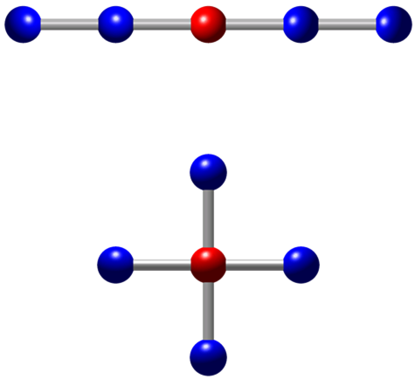
Implementing IComparable<T>
Live Demo

Slide 30

The IEnumerable<T> Interface

Slide 31
IEnumerable<T>
The IEnumerable<T> interface provides collection classes with foreach traversal
It consists of 4 interfaces: IEnumerable<T>, IEnumerable, IEnumerator<T>, IEnumerator
public interface IEnumerable<T> : IEnumerable
{
IEnumerator<T> GetEnumerator();
}
// Non-generic version (compatible with .NET 1.1)
public interface IEnumerable : IEnumerable
{
IEnumerator GetEnumerator();
}

Slide 32
IEnumerator<T>
The IEnumerator<T> interface provides sequential read-only, forward-only iterator
public interface IEnumerator<T> : IEnumerator
{
bool MoveNext();
void Reset();
T Current { get; }
}
public interface IEnumerator
{
bool MoveNext();
void Reset();
object Current { get; }
}

Slide 33
Yield Return in C#
The yield return construct in C# simplifies the IEnumerator<T> implementations
When a yield return statement is reached
The expression is returned, and the current location in code is retained (for later use)
public IEnumerator<int> GetEnumerator()
{
for (int i=100; i<200; i++)
{
yield return i;
}
}

Slide 34
Implementing IEnumerable<T>
Live Demo

Slide 35

Value Types

Slide 36

Value Types
Store their values in the stack
Can not hold null value
Destroyed when the given variable goes out of scope
When a method is called they are:
Passed by value
Stored in the stack (copied)

Slide 37

Value Types (2)
Inherit System.ValueType
Value types are:
Primitive types
int, char
float, bool
Others
Structures
Enumerations (enumerable types)

Slide 38

Reference Types

Slide 39
Reference Types
Implemented as type-safe pointers to objects
Stored in the dynamic memory
When a method is called they are passed by reference (by their address)
Automatically destroyed by the CLR Garbage Collector, when they are out of scope or they are not in use
Can hold null value

Slide 40

Reference Types (2)
It is possible for many variables to point to one and the same reference type object
Referent objects are:
System.Object, System.String
Classes and interfaces
Arrays
Delegates
Pointers

Slide 41

Value vs. Reference Types
Assigning, Memory Location and Values

Slide 42
Assigning Values
Value Types
When assigning value types, their value is copied to the variable
Reference Types
When assigning referent type, only the reference (address) is copied and the objects stays the same

Slide 43

Memory Location
The memory location for value types is the program execution stack
The memory location for reference types is the dynamic memory
Also called managed heap

Slide 44
Values
Value types can not take null as a value, because they are not pointers
Value types inherit System.ValueType
Reference types inherit System.Object
Value type variables can be stored in reference types with the boxing technique

Slide 45
Value and Reference Types - Example
class RefClass { public int value; } // Reference type
struct ValStruct { public int value; } // Value type
class TestValueAndReferenceTypes
{
static void Main()
{
RefClass refExample = new RefClass();
refExample.value = 100;
RefClass refExample2 = refExample;
refExample2.value = 200;
Console.WriteLine(refExample.value); // Prints 200
ValStruct valExample = new ValStruct();
valExample.value = 100;
ValStruct valExample2 = valExample;
valExample2.value = 200;
Console.WriteLine(valExample.value); // Prints 100
}
}

Slide 46
Types, Variables and Memory
Stack for program execution
Dynamic memory (managed heap)
Address
Value
Variable
Address
Value
...
...
(stack beginning)
...
...
...
...
class1
0x0012F680
0x04A41A44
class2
0x0012F67C
0x04A41A44
0x04A41A44
200
struct1
0x0012F678
100
...
...
struct2
0x0012F674
200
...
...
(free stack memory)
...
...
...
...
(end of stack)
0x00000000
...
...
...

Slide 47

Value and Reference Types
Live Demo

Slide 48



Boxing and Unboxing

Slide 49

Boxing and Unboxing
Value types can be stored in reference types
If needed CLR boxes and unboxes value types
Boxing is operation, that converts a value type to a reference one
Unboxing is the opposite operation
Converts boxed value to ordinary value type

Slide 50

Boxing
Allocates dynamic memory for the creation of the object
Copies the contents of the variable from the stack to the allocated dynamic memory
Returns a reference to the created object in the dynamic memory
The original type is memorized
The dynamic memory contains information, that the object reference holds boxed object

Slide 51


Unboxing
If the reference is null a NullReferenceException is thrown
If the reference does not point to a valid boxed value an InvalidCastException is thrown
The value is pulled from the heap and is stored into the stack

Slide 52
Boxing Value Types
Stack
Heap
int i=5;
obj
i=5
(value-type
variable in
the stack)
object obj = i;
5
(boxing)
(boxed
value-type
variable
in the heap)
i2=5
(value-type
variable in
the stack)
int i2;
i2 = (int) obj;
(unboxing)

Slide 53
Boxing and Unboxing – Example
using System;
class TestBoxingUnboxing
{
static void Main()
{
int value1 = 1;
object obj = value1; // boxing performed
value1 = 12345; // only stack value is changed
int value2 = (int)obj; // unboxing performed
Console.WriteLine(value2); // prints 1
long value3 = (long) (int) obj; // unboxing
long value4 = (long) obj; // InvalidCastException
}
}

Slide 54

Boxing and Unboxing Primitive Types
Live Demo

Slide 55
Boxing and Unboxing – Example
interface IMovable
{
void Move(int x, int y)
}
// Very bad practice! Structures should
// contain no logic, but only data!
struct Point : IMovable
{
public int x, y;
public void Move(int x, int y)
{
this.x += x;
this.y += y;
}
}

Slide 56

Boxing and Unboxing Custom Types
Live Demo

Slide 57

Passing Parameters
ref and out Keywords

Slide 58
Passing Parameters
Parameters can be passed in several ways to the methods:
in (default)
Passing value for value types
Passing heap address for reference types
out
Passed by stack address for both value types and reference types
The initialization can be done by the called method

Slide 59

Passing Parameters
Parameters can be passed in several ways to the methods:
ref
Passed by stack address for both value types and reference types
Initialization can't be done by the called method – access is for read and write

Slide 60
ref Parameters – Example
public class Student
{
public string name;
static void IncorrectModifyStudent(Student student)
{
student = new Student("Changed: " + student.name);
}
static void ModifyStudent(ref Student student)
{
student = new Student("Changed: " + student.name);
}
static void Main()
{
Student s = new Student("Nakov");
Console.WriteLine(s.name); // Nakov
IncorrectModifyStudent(s);
Console.WriteLine(s.name); // Nakov
ModifyStudent(ref s);
Console.WriteLine(s.name); // Changed: Nakov
}
}

Slide 61

ref Parameters
Live Demo

Slide 62
out Parameters – Example
class TestOutParameters
{
static void Main()
{
Rectangle rect = new Rectangle(5, 10, 12, 8);
Point location;
Dimensions dimensions;
// Location and dimension are not pre-initialized!
rect.GetLocationAndDimensions(
out location, out dimensions);
Console.WriteLine("({0}, {1}, {2}, {3})",
location.x, location.y,
dimensions.width, dimensions.height);
// Result: (5, 10, 12, 8)
}
}

Slide 63

out Parameters
Live Demo

Slide 64
Common Type System
http://academy.telerik.com

Slide 65
Exercises
Define a class Student, which contains data about a student – first, middle and last name, SSN, permanent address, mobile phone e-mail, course, specialty, university, faculty. Use an enumeration for the specialties, universities and faculties. Override the standard methods, inherited by System.Object: Equals(), ToString(), GetHashCode() and operators == and !=.
Add implementations of the ICloneable interface. The Clone() method should deeply copy all object's fields into a new object of type Student.

Slide 66
Exercises (2)
Implement the IComparable<Student> interface to compare students by names (as first criteria, in lexicographic order) and by social security number (as second criteria, in increasing order).
Create a class Person with two fields – name and age. Age can be left unspecified (may contain null value. Override ToString() to display the information of a person and if age is not specified – to say so. Write a program to test this functionality.
Define a class BitArray64 to hold 64 bit values inside an ulong value. Implement IEnumerable<int> and Equals(…), GetHashCode(), [], == and !=.

Slide 67
Exercises (3)
* Define the data structure binary search tree with operations for "adding new element", "searching element" and "deleting elements". It is not necessary to keep the tree balanced. Implement the standard methods from System.Object – ToString(), Equals(…), GetHashCode() and the operators for comparison == and !=. Add and implement the ICloneable interface for deep copy of the tree. Remark: Use two types – structure BinarySearchTree (for the tree) and class TreeNode (for the tree elements). Implement IEnumerable<T> to traverse the tree.

